Slide 1
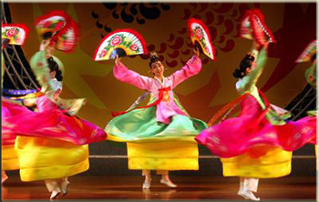
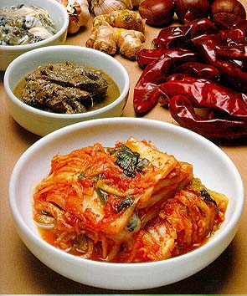
Korea and Its Traditions
China had a large influence on Korea:
Absorbed many Chinese customs but maintained separate, distinct culture. Influencing:
Writing
Farming
Confucian ideas in running the government, & much more
Controlled by China as a tributary state from 108 BC, and for the next 500 years
A tributary state must acknowledge the dominant state as being in charge and pay tribute such as taxes/money and goods, as well as sending soldiers when necessary.

Slide 2
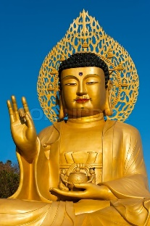
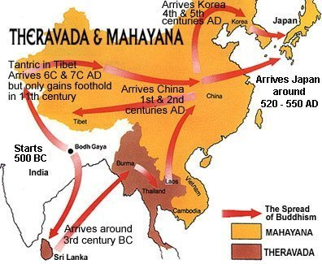
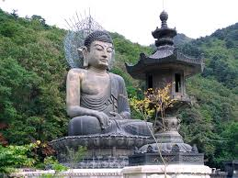
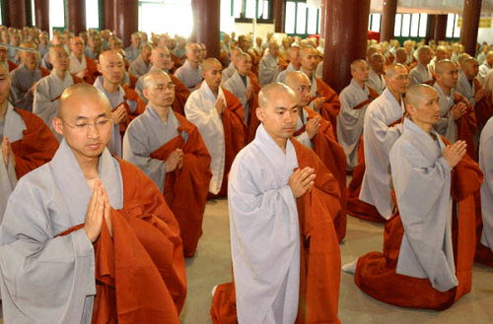
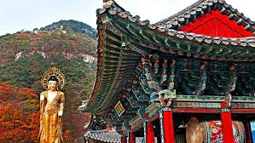
Buddhism in Korea was greatly influenced by India:
First brought over by Indian traders in the first century A.D.
The most popular initial forms of Buddhism were: the Samnon 三論宗) school, which focused on the Indian (Mahayana) Mādhyamika (Middle Path) doctrine.
Korea and Its Traditions

Slide 3
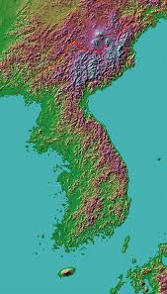
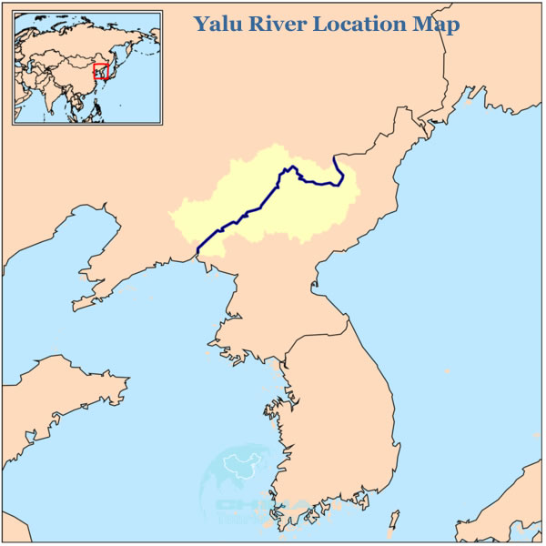
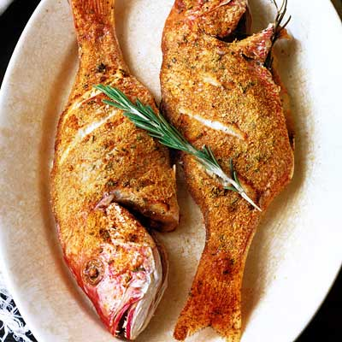
Korea and Its Traditions
Geography of the Korean Peninsula:
most people lived and farmed on the western coastal plains
70% is mountainous.
Many good harbors
Thousands of islands
Korea has one of the largest fishing industries in world.

Slide 4
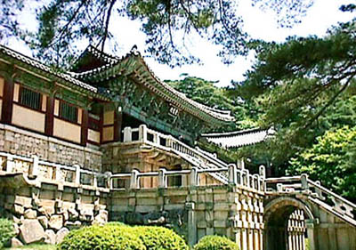
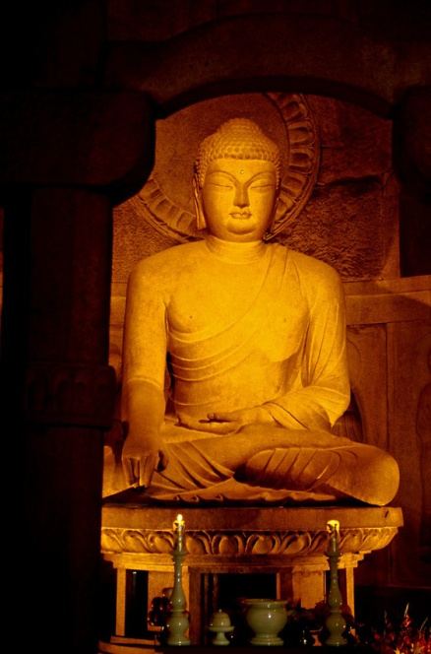
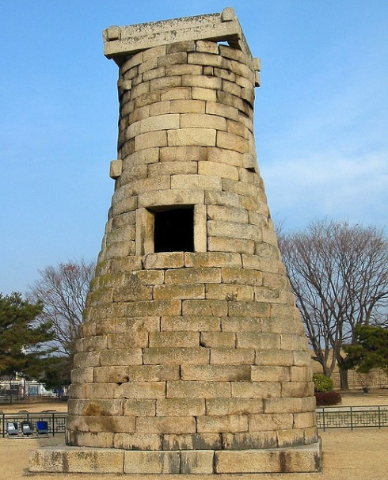
Silla Dynasty Unites Kingdom
Ruled 668 – 935 A.D.
Arts flourished / very prosperous
Buddhism grew /many temples built
Traded with China
Kyongigiu, capital city, “city of gold”
Medicine, astronomy, metal casting, sculpture and textile manufacturing reached high levels
Aristocrats pursued life of extravagance
Conflicts between peasants and aristocrats caused overthrow of dynasty
Korean Astronomical tower

Slide 5
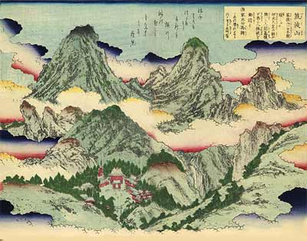
Koryo Dynasty (Goryeo) invaded Silla in 918
For 17 years there was conflict between the Silla and Koryo Dynasties.
Koryo Dynasty Ruled from 935 – 1392. However…
from 1225 to 1392 the Mongols had some control – (see slides ahead.)
“Korea” comes from “Koryo”
Confucian & Buddhism were influential in Korea and were very widespread.
Improved on the movable type; now able to print large numbers of books.
The Koryo Dynasty
Korean woodblock Print
Used woodblock printing to make many Buddhist texts and beautiful artwork.

Slide 6
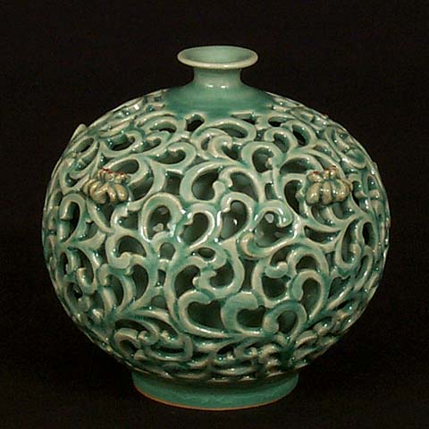
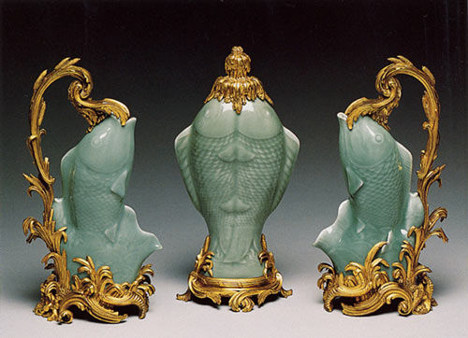
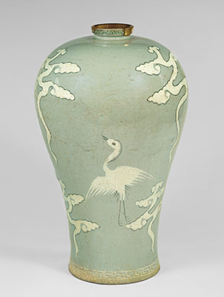
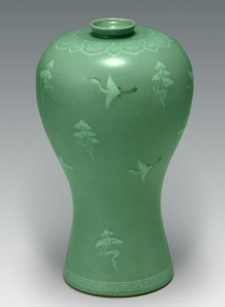
The Koryo Dynasty
Made celadon porcelain with a blue-green glaze – famous and highly prized even today
In the 1200s Mongols took over; they lost the art of celadon glazing forever ☹

Slide 7
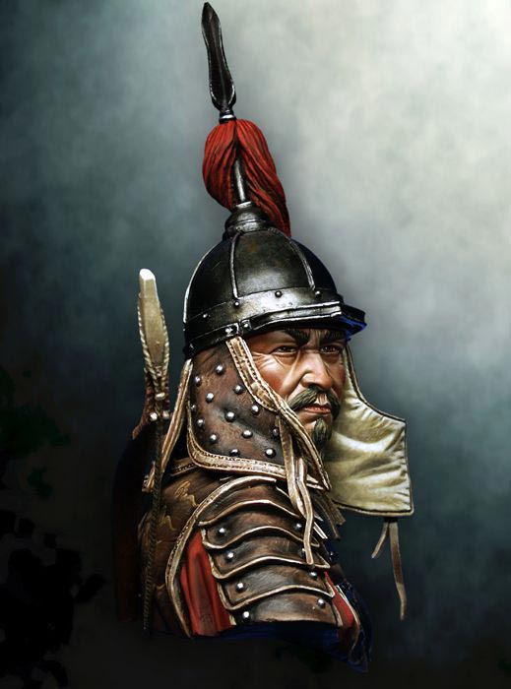
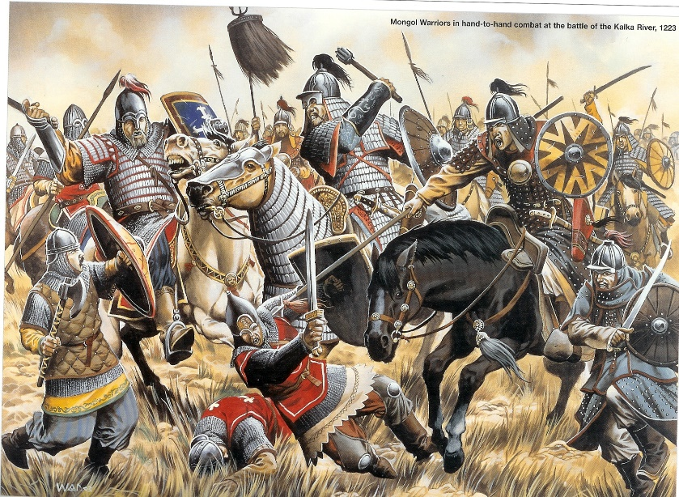
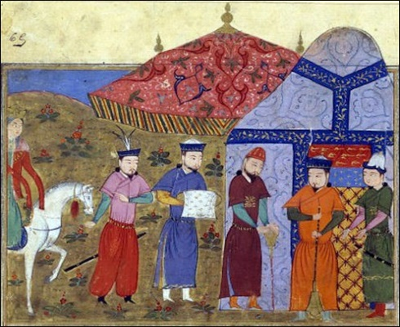
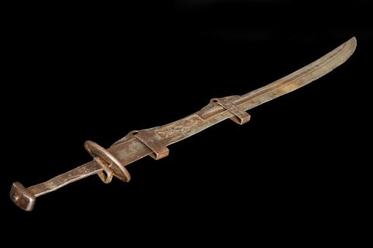
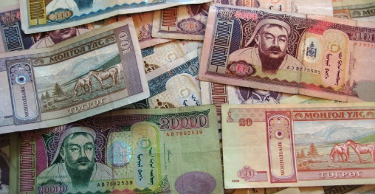
Mongols demanded tribute from the Koryos in 1225 and then invaded and fought from 1231 through 1270.
MANY, MANY deaths!!!!
1270 – 1356 Korea became a vassal/tributary state of the Mongols.
The Mongols now ruled the Koryo Dynasty. The families did intermarry and there was a spreading and mix of cultures – cultural diffusion
Vassal/tributary state = must accept the authority of, and be subordinate to, the dominant state. They must provide military assistance and pay tribute and or taxes – such as $ and/or goods.

Slide 8
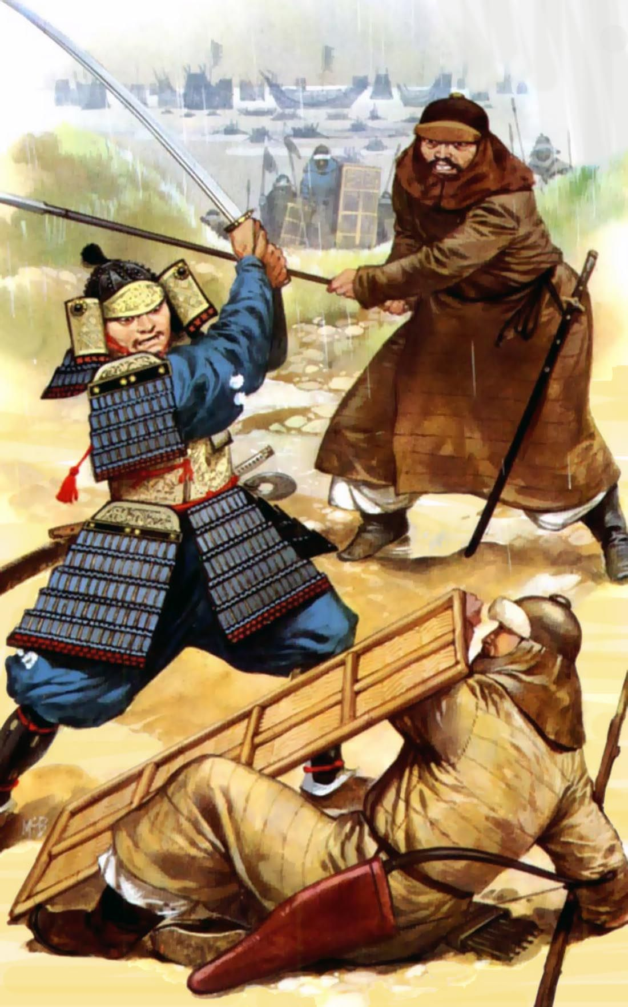
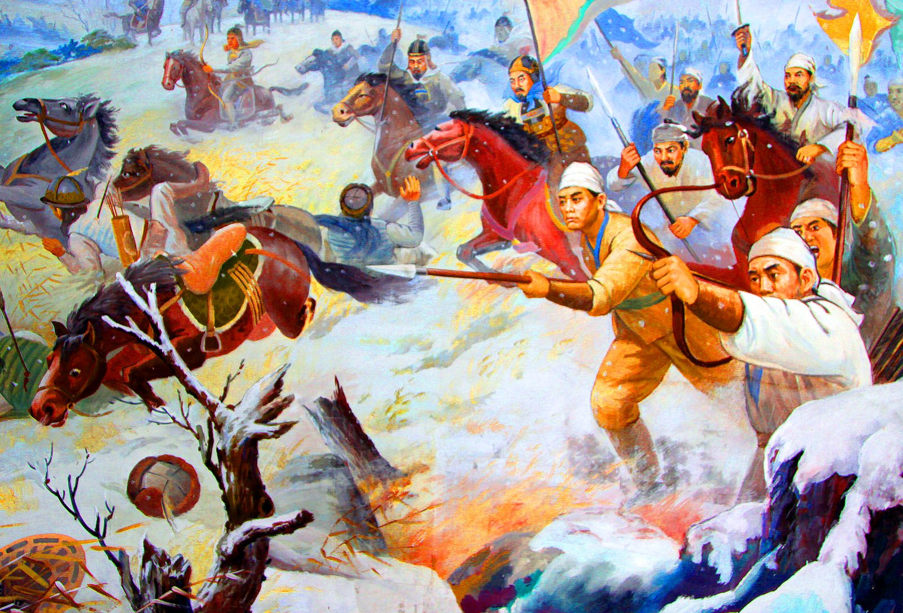
Koreans Fight for Freedom
The Koreans then began fighting for freedom from the Mongols’ crumbling Empire from 1350 - 1392

Slide 9
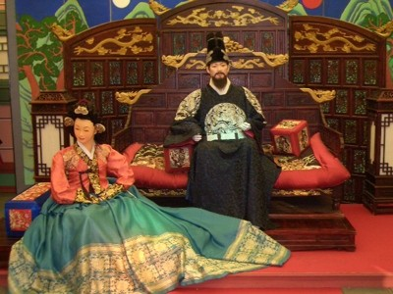
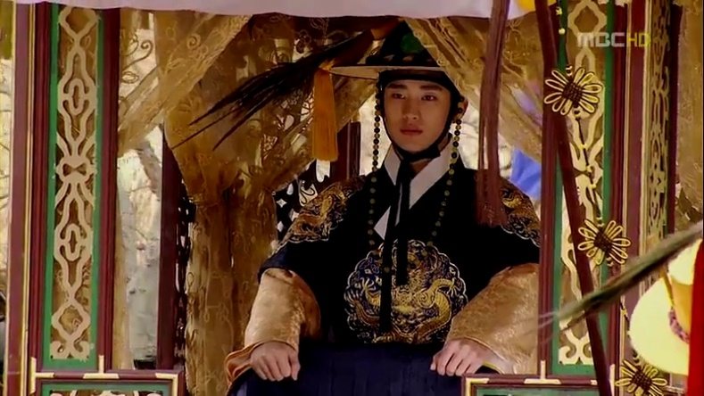
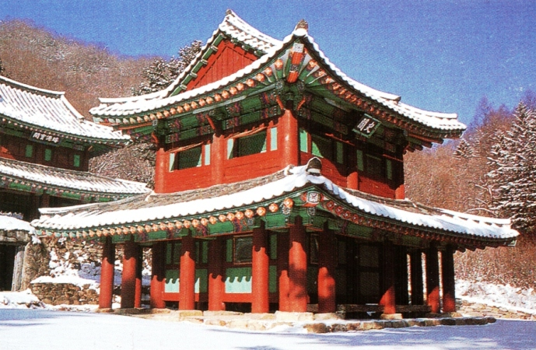
Choson Dynasty
1392 finally overthrew Mongols – Choson Dynasty begins
1392 – 1897 (1910)
Last & longest lived dynasty – based on Confucian principles

Slide 10
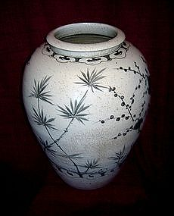
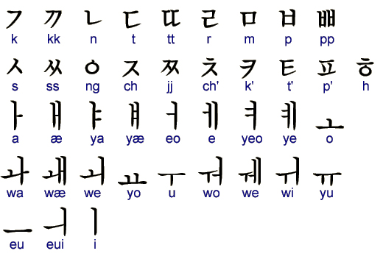
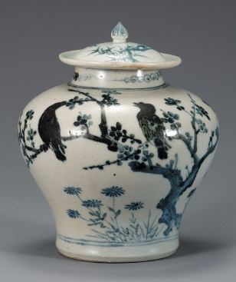
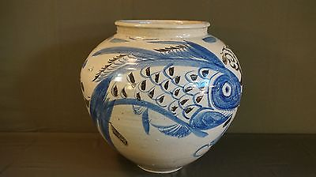
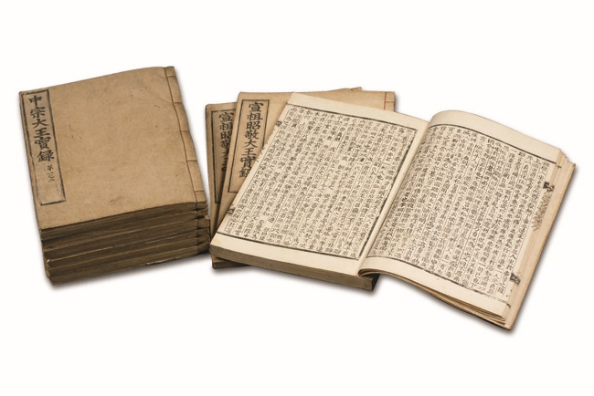
Choson Dynasty
1443 developed Korean phonetic alphabet = hangul
Easy to learn and read = high literacy
Joseon (Choson) white porcelain or Joseon baekja refers to the white porcelains produced during the Joseon dynasty (1392-1910). Considered to represent the highest quality of achievements.

Slide 11
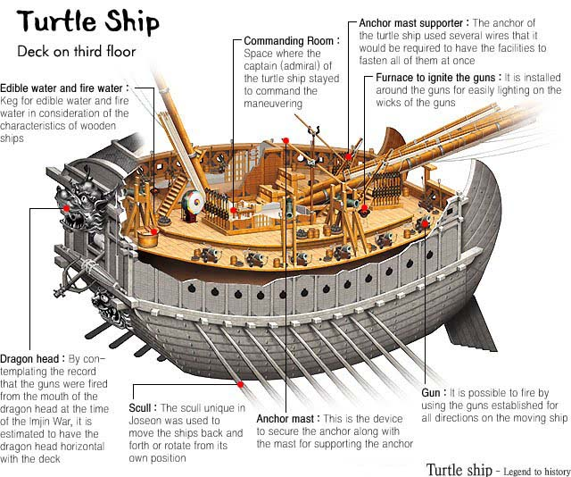

Slide 12
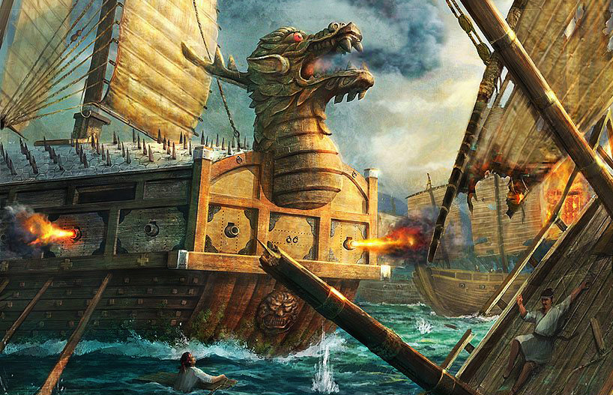
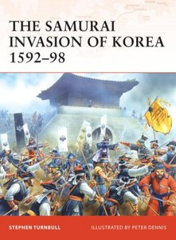
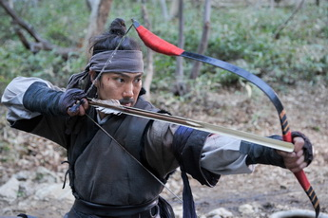
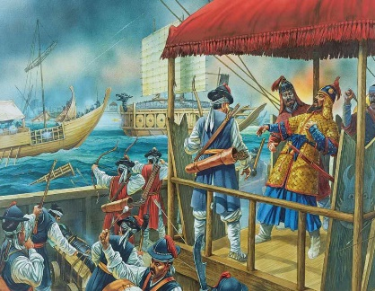
Japan invades in 1590s
Korea used turtle ships to repel them (armored and shaped like turtles)
In 6 years they kicked out the Japanese
Carried off many Korean artists to gain skills

